Slide 1

Privacy-Preserving Human Emotion Recognition in Multi-sensor Device

Slide 2
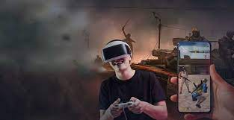
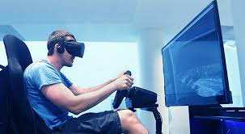
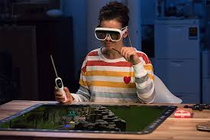
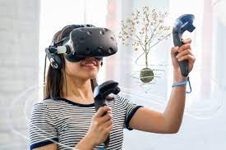
VR/AR Gaming

Slide 3
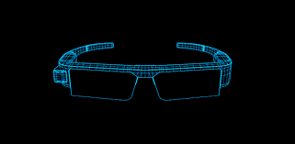
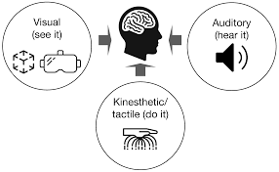
Immersive User Experience
Human Emotion Recognition is one of common ways to improve the immersive experience.

Slide 4
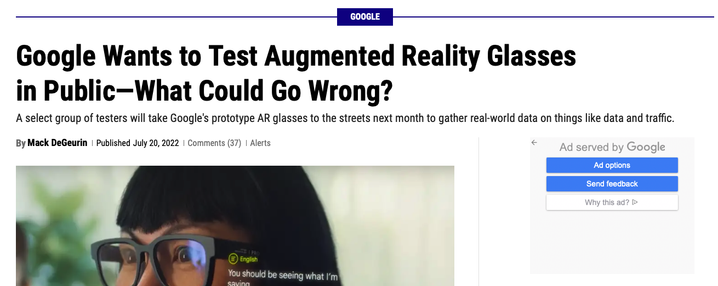
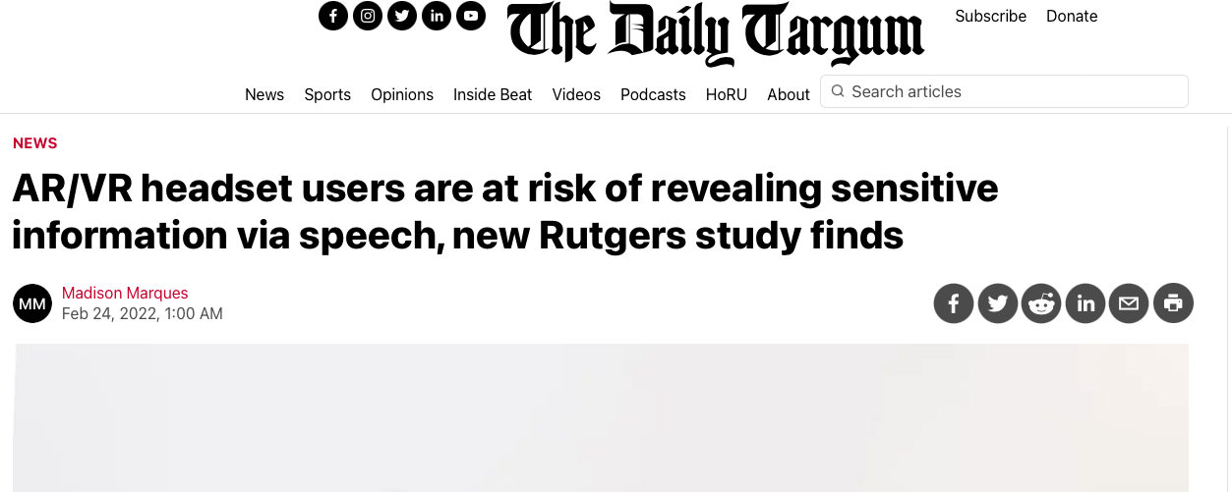
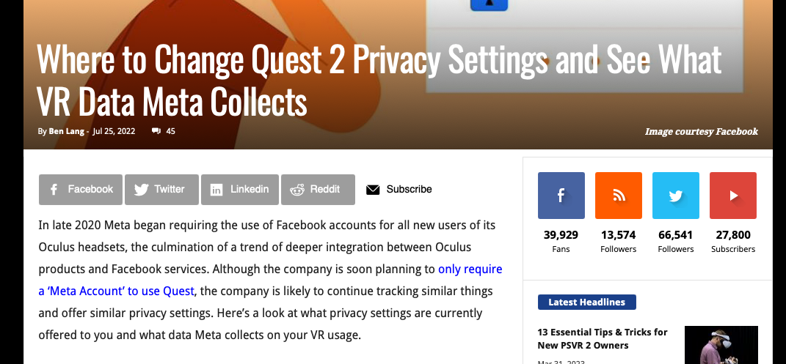
Privacy Leakage in VR/AR

Slide 5


Data Flow of Human Emotion Recognition in Multi-sensor Device
Video Recording
Multimodal Data Features
Audio Recording
Multi-sensor Device
Edge Server
Emotion Prediction Result

Slide 6

Attack Systems
1. During data feature transmission:
Multimodal Data Features
Multi-sensor Device
Feature-based Inference Attack
Edge Server

Slide 7
Attack Systems
2. During the prediction result transmission:
Emotion Prediction Results
Multi-sensor Device
Output-based Attack
Edge Server

Slide 8
Data Privacy Protection Mechanisms in Multi-sensor Device
1. Access Restriction Scheme
2. Encryption-based Approach
3. Anonymization-based Method
4. Noise-based Model

Slide 9
Challenges
We want to use Differential Privacy (DP) to achieve privacy protection, but it cannot be directly used in the privacy protection of multimodal data in the multi-sensor device.
1. Multimodal Data Heterogeneity
It is important to embed multimodal data into the same feature space.
2. Multimodal Data Correlation
The correlation can be considered as a kind of side-channel information to decrease the performance of DP protection degree in terms of feature-based inference attacks.
3. Multi-source Prediction Correlation
Similarly, the correlation can be considered as a kind of side-channel information to decrease the performance of DP protection degree with respect to output-based attacks.

Slide 10
Differential Private Correlated Feature Learning (DPCRL)
Solve the challenges of Multimodal Data Heterogeneity and Multimodal Data Correlation
Specific Video Representations + Laplace Noise
Video Recording
Correlated Video Representations + Laplace Noise
Audio Recording
Correlated Audio Representations + Laplace Noise
Specific Audio Representations + Laplace Noise
Multi-sensor Device

Slide 11
Advantage of DPCFL
Naïve Differential Privacy
≈
Audio Features
+ Laplace Noise
Video Features
+ Laplace Noise
Our Scheme (DPCFL)
≈
Specific Video Representations + Laplace Noise
Correlated Video Representations + Laplace Noise
Specific
Shared
Specific
Correlated Audio Representations + Laplace Noise
Specific Audio Representations + Laplace Noise

Slide 12
Two kinds of Differential Private Emotion Prediction Schemes
Based on Feature-fusion Emotion Prediction Model
Based on Decision-fusion Emotion Prediction Model
1. Video-based Emotion Prediction + Laplace Noise
2. Audio-based Emotion Prediction + Laplace Noise
1. Feature Fusion
2. Emotion Prediction
3. Emotion Prediction + Laplace Noise
3. Decision Fusion
Edge Server
Edge Server
Differential Private Feature-fusion Emotion Prediction
Differential Private Decision-fusion Emotion Prediction

Slide 13
Solve the challenge of Multi-source Prediction Correlation
Naïve Differential Privacy (Option 1)
≈
Audio Prediction Output Result
Video Prediction Output Result
+ Laplace Noise
+ Laplace Noise
Naïve Differential Privacy (Option 2)
≈
+ Laplace Noise

Slide 14
Solve the challenge of Multi-source Prediction Correlation
Our Scheme (Differential Private Decision-fusion Emotion Prediction)
≈
Specific Video Output Result + Laplace Noise
Specific
Shared
Specific
Correlated Video Output Result + Laplace Noise
Correlated Audio Output Result + Laplace Noise
Specific Audio Output Result + Laplace Noise

Slide 15
Privacy-Preserving Feature-fusion Human Emotion Recognition
Combine DPCFL and Differential Private Feature-fusion Emotion Prediction
Specific Video Representations + Laplace Noise
Video Recording
Correlated Video Representations + Laplace Noise
Audio Recording
Correlated Audio Representations + Laplace Noise
Specific Audio Representations + Laplace Noise
Edge Server
Multi-sensor Device
Privacy-Preserving Emotion Prediction Result
1. Feature Fusion
2. Emotion Prediction
3. Emotion Prediction + Laplace Noise

Slide 16
Privacy-Preserving Decision-fusion Human Emotion Recognition
Combine DPCFL and Differential Private Decision-fusion Emotion Prediction
Specific Video Representations + Laplace Noise
Video Recording
Correlated Video Representations + Laplace Noise
Audio Recording
Correlated Audio Representations + Laplace Noise
Specific Audio Representations + Laplace Noise
Edge Server
Multi-sensor Device
1. Video-based Emotion Prediction + Laplace Noise
2. Audio-based Emotion Prediction + Laplace Noise
Privacy-Preserving Emotion Prediction Result
3. Decision Fusion

